Slide 1
Importance sampling strategy for stochastic oscillatory processes
Jan Podrouzek
TU Wien, Austria

Slide 2
General Framework
Performance based design - fully probabilistic assessment
Formulation of new sampling strategy reducing the MC computational task for temporal loads

Slide 3
Current status
No such attempt seen in literature
Why? -> my motivation to try

Slide 4
Background
The necessity for adopting fully probabilistic design concepts has become imperative among the structural static problems
Structural dynamics: uncertain nature of environmental loading as time-varying phenomena
-> MC based reliability analysis computationally unfeasible for realistic assumptions
-> Finite set of rules capable of classifying synthetic samples of stochastic processes?
-> New Importance Sampling Strategy for stochastic oscillatory processes

Slide 5
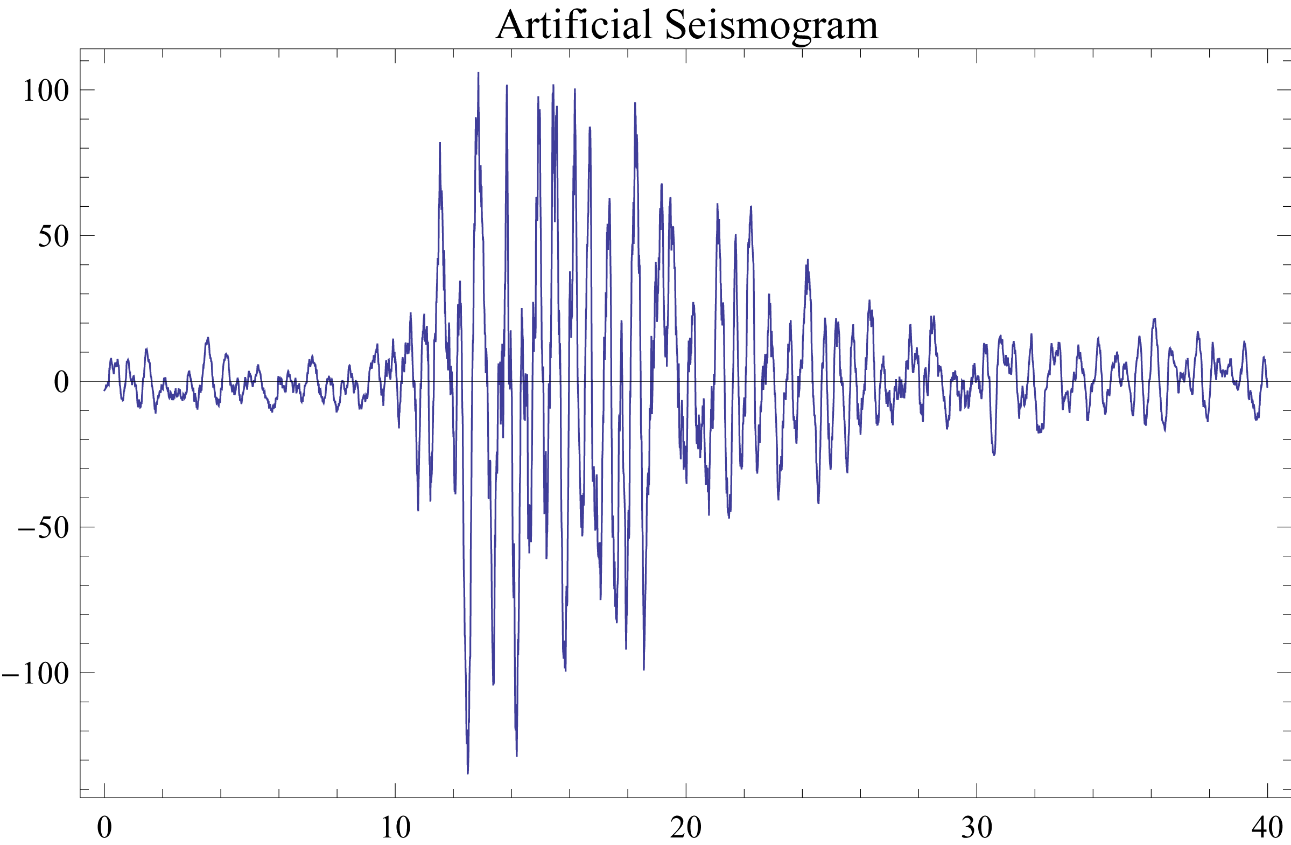
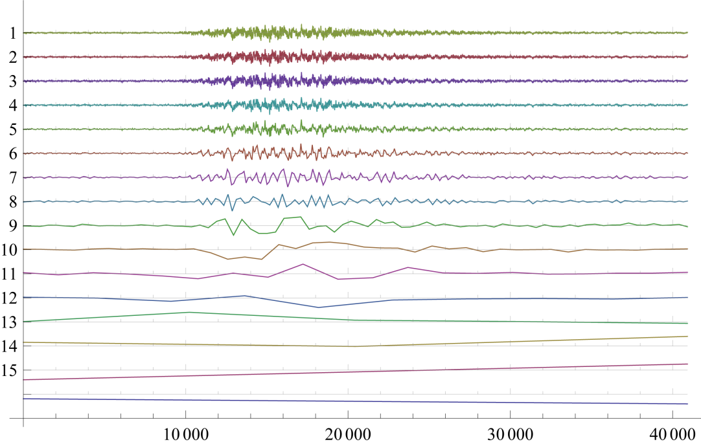
Stochastic processes
Transformed into graphics…

Slide 6
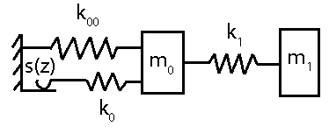
Probabilistic design
...structures respond in a very uncertain manner to different ground motion events -> necessity to perform the structural analysis for each realization of the event separately
Monte-Carlo based reliability analysis computationally unfeasible for realistic assumptions, i.e. small probabilities and large sample sizes
e.g. FEM
Recent attempts in literature to avoid such reliability problem in its full form.
Interest in most unfavorable scenario
Requirement for large number of repeated analyses

Slide 7
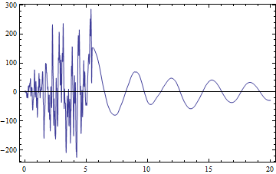
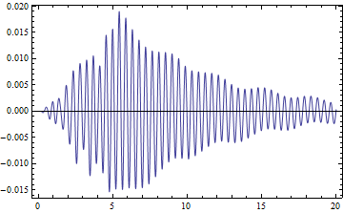
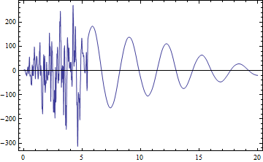
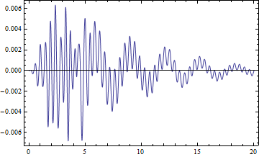
Probabilistic design
...structures respond in a very uncertain manner to different ground motion events -> necessity to perform the structural analysis for each realization of the event separately
Monte-Carlo based reliability analysis computationally unfeasible for realistic assumptions, i.e. small probabilities and large sample sizes
e.g. FEM
Recent attempts in literature to avoid such reliability problem in its full form.
Interest in most unfavorable scenario
Requirement for large number of repeated analyses

Slide 8
Probabilistic design
...structures respond in a very uncertain manner to different ground motion events -> necessity to perform the structural analysis for each realization of the event separately
Monte-Carlo based reliability analysis computationally unfeasible for realistic assumptions, i.e. small probabilities and large sample sizes
Goal of this research: maintain the up-to-date most conceptually correct fully probabilistic concept while reducing the number of required analyses by means of the proposed identification framework STS
e.g. FEM
Recent attempts in literature to avoid such reliability problem in its full form.
Interest in most unfavorable scenario
Requirement for large number of repeated analyses

Slide 9
Development
Identification strategy development follows a transparent image processing paradigm completely independent of state-of-the-art structural dynamics
Reason behind such premise is experimental, aiming at delivering simple and wide-purpose method
Goal: find the critical realization of a stochastic process from a target sample set under defined critical response criteria

Slide 10
Development
Extract the important features of critical processes from the ranked training sample set
Look for these features in the original sample set
According to these features assign importance coefficients to each realization in the full set
Assume that the realizations with highest importance coefficients are the most critical

Slide 11
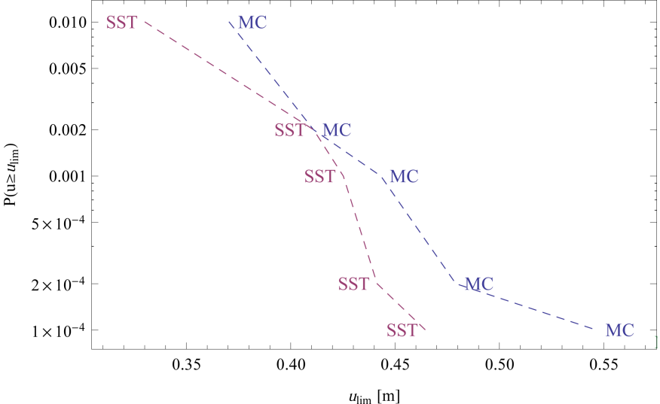
Development
Probability of exceeding a critical displacement threshold u_{lim}:
MC (100%) vs. STS based importance sampling at 4.6% of computational cost
Potential for improvement?

Slide 12
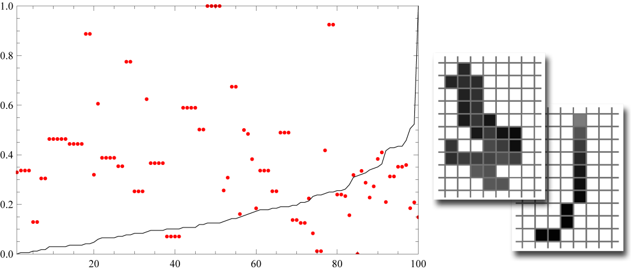
STS
The evidence of absence of a trend in ranked CE point cloud and the possible solution (left) in form of a simple CA surveying the surrounding of a localized seed – and example of directional (avoided) and cyclic pattern

Slide 13
Identification of critical stochastic processes
Recent progress:
incorporation of robust descriptors -> better agreement with the reference MC method
Emerging question:
What is the relationship (R) between the frequency characteristic of the loading process (p), the frequency char. of the oscillators (m) and the predictive confidence (c)?

Slide 14
Identification of critical stochastic processes
information carrying cells can be distinguished by two categories:
Fist category cells are those that exhibit constant or random behaviour when confronted with the ranked results of the training set.
Second category cells exhibit a systematic behaviour in contrast to the first category cells.
The most important part is, however, how to reproduce these features in a robust way so that the second category cells when confronted with GS realizations are capable of classifying these according to the evidence from S_{t}.

Slide 15
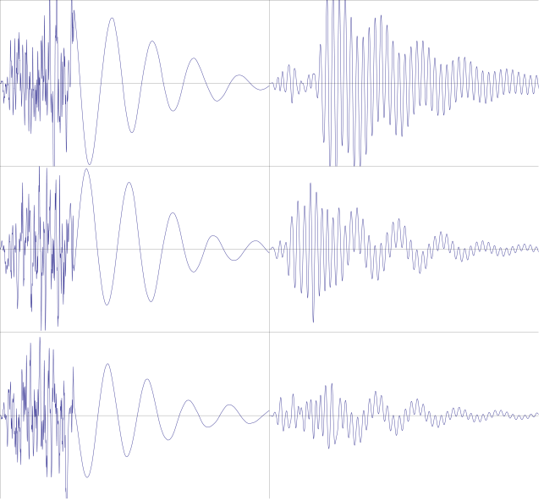
STS
Solve the training process-model interactions: S_{t} → C_{rt}.
Construct ranked n max. and min. GS_{t} sets according to C_{rt}: GS_{crtMax}, GS_{crtMin}.
Sample realizations of M1-L2 process-model scenario (left-right column); even the simplest model of mechanical oscillator responds in a dramatically different manner to similar excitation patterns, first row representing the critical excitation-response pattern.

Slide 16
STS
For each cell in all layers quantify the differences ǀGS_{crtMax} - GS_{crtMin}ǀ: D_{r}, D_{g}, D_{b}.
Identify the second category cells: CA².
$$\text{True} \text{if} {\text{D}}_{\left\{r,g,b\right\},i,j}≥{\text{0.995}}^{\text{th}} \text{upper} \text{quantile} \text{from} {\text{D}}_{\left\{r,g,b\right\}}$$

Slide 17
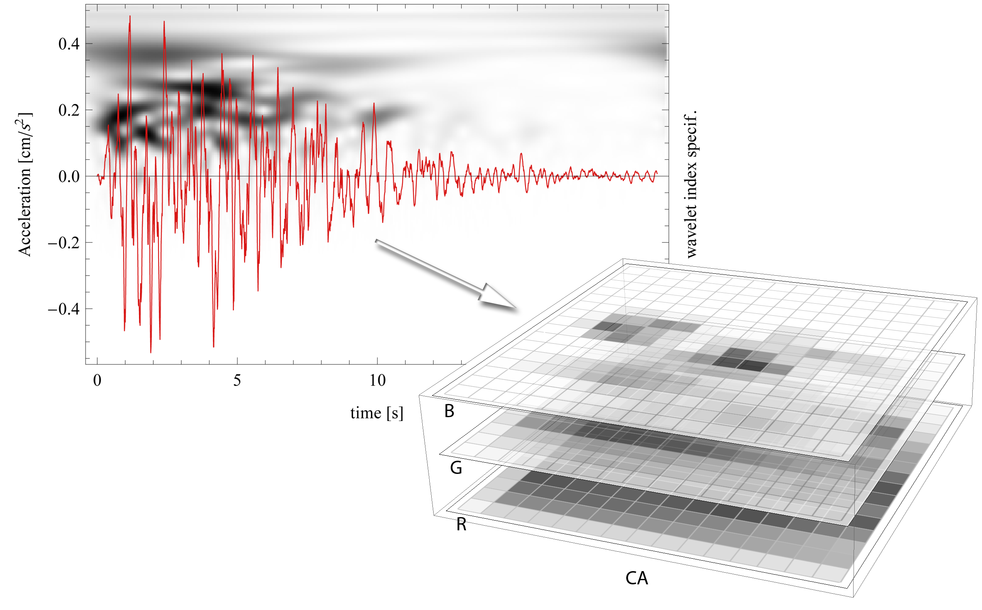
STS
For each realization of GS_{T} quantify the CE product as a sum of CA² cells after the proposed transformation:
a) Seed the GS_{Ti} according to CA².
b) In a succession of time steps spread the initial seed in the largest neighbor direction.
c) After t time steps the initial seed evolves into various patterns.
d) For the quantification of the CE product, incorporate only cells from emergent cyclic and non-directional patterns.

Slide 18
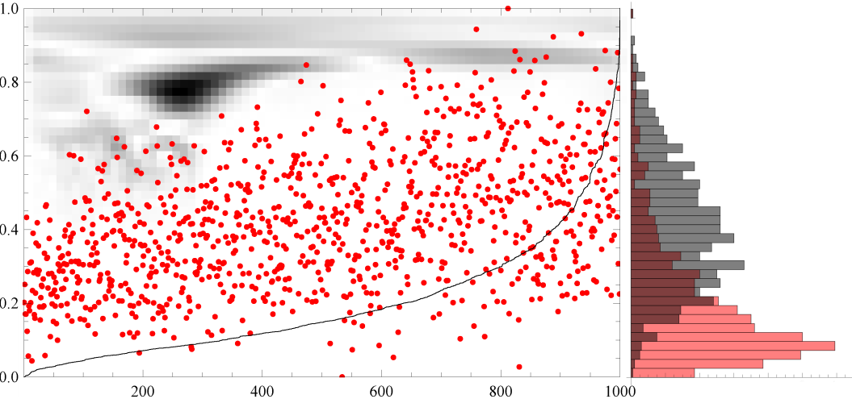
STS
Obtain the first c critical stochastic processes from S_{T} by selecting the c ranked maxima of the CE product.

Slide 19
STS
Solve the training process-model interactions: S_{t} → C_{rt}.
Construct ranked n max. and min. GS_{t} sets according to C_{rt}: GS_{crtMax}, GS_{crtMin}.
For each cell in all layers quantify the differences ǀGS_{crtMax} - GS_{crtMin}ǀ: D_{r}, D_{g}, D_{b}.
Identify the second category cells: CA².
$\text{True} \text{if} {\text{D}}_{\left\{r,g,b\right\},i,j}≥{\text{0.995}}^{\text{th}} \text{upper} \text{quantile} \text{from} {\text{D}}_{\left\{r,g,b\right\}}$ (1)
For each realization of GS_{T} quantify the CE product as a sum of CA² cells after the following transformation:
Seed the GS_{Ti} according to CA².
In a succession of time steps spread the initial seed in the largest neighbor (Moor 8) direction.
After t time steps the initial seed evolves into various patterns.
For the quantification of the CE product, incorporate only cells from emergent cyclic and non-directional patterns.
Obtain the first c critical stochastic processes from S_{T} by selecting the c ranked maxima of the CE product.

Slide 20
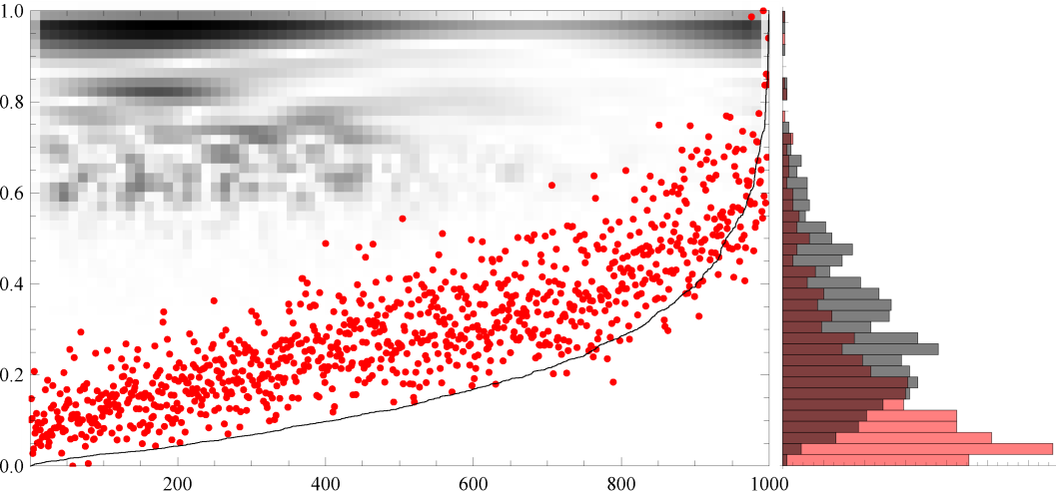
STS
Visualization of the D_{b} matrix for L1-M3 on a background of CE point cloud ranked according to the C_{r}. Histogram on the right shows the difference between the CE and more uniformly distributed C_{r}.

Slide 21
STS
Scattering of the L2-M2 ranked CE point cloud indicates smaller STS confidence when compared to Fig. 4, however, a significant improvement when compared to the scalar based approach (Fig. 3). Note the different D_{b} coefficients pattern lacking a dominant frequency.

Slide 22
Conclusion
Successful implementation of importance sampling for stochastic oscillatory processes
Tested on both stationary and non-stationary processes (frequency and amplitude modulated processes)
By introducing robust measures 100% agreement with reference MC (higher computational cost as a tradeoff)

Slide 23
Outlook
e.g.
STS and POD on a real bridge structure:
Sampling reduction to 2%
ca 3000 DOF constrained to 16
And more realistic process-model scenarios generally.
Thank you for your attention

Slide 24
Thank you

