Slide 1
6th International Workshop on Reliable Engineering Computing (REC 2014)
Illinois Institute of Technology
Chicago, IL, USA

Slide 2
REC 2014 Theme
Reliable Computing for Infrastructures

Slide 3
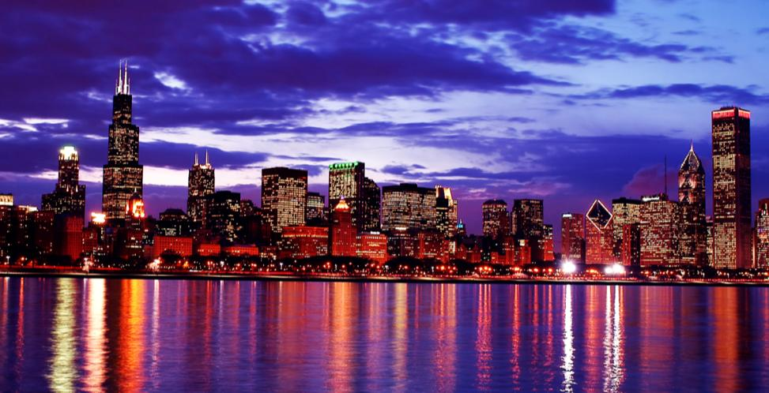
Chicago
Located in the heart of the Midwest US, Chicago is the third largest in the country.

Slide 4
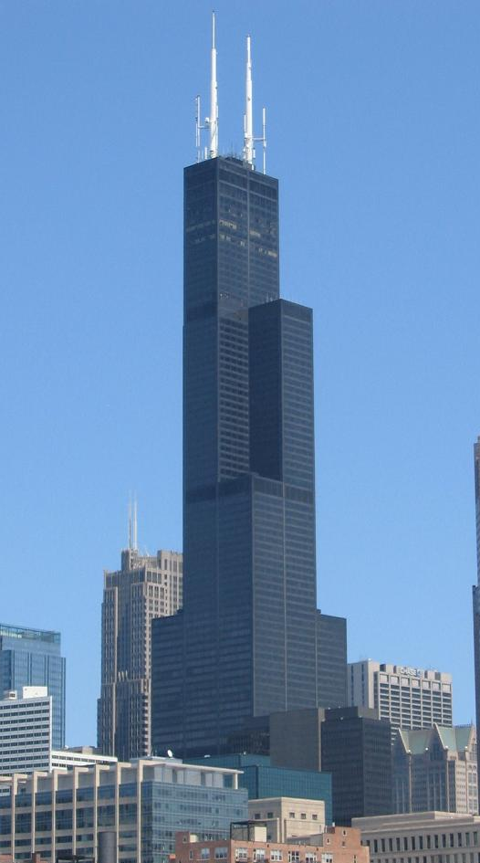
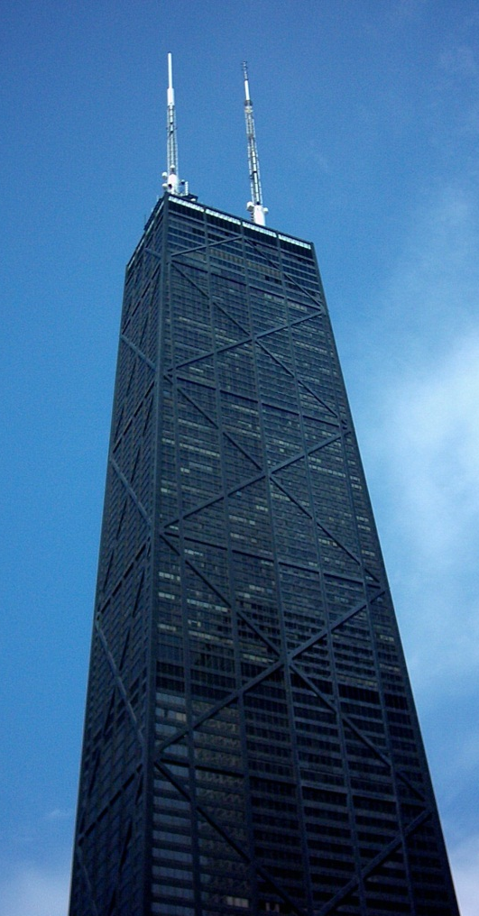
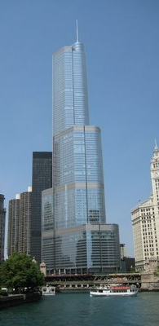
Landmarks of Chicago
Willis Tower - tallest building in North America
John Hancock Center
Trump Tower

Slide 5
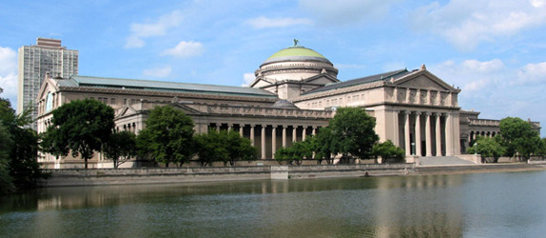
Art Institute of Chicago - largest
collection of Impressionist paintings outside of the Louvre in Paris
The Museum of Science & Industry - largest science museum in the Western Hemisphere

Slide 6
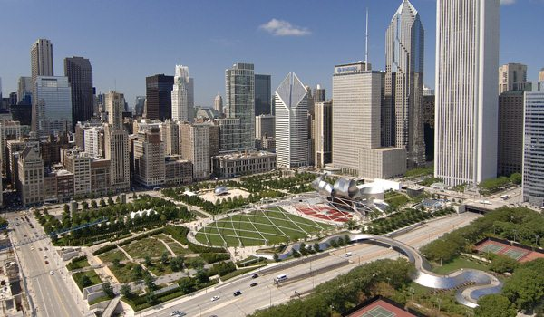
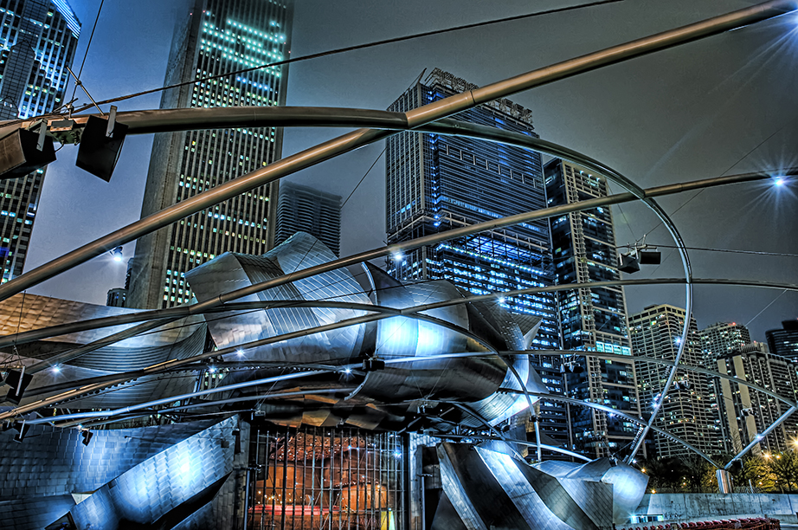
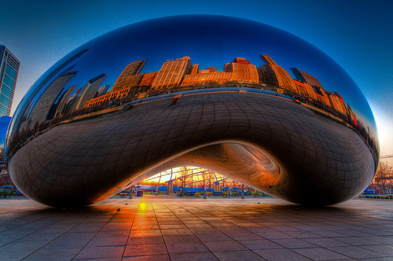
Millennium Park
Jay Pritzker Pavilion
Cloud Gate aka ‘The Bean’

Slide 7
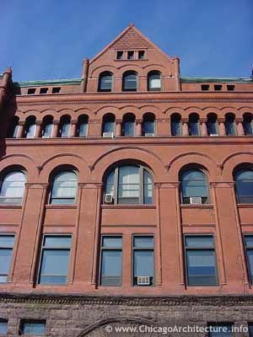
Illinois Institute of Technology (IIT)
Founded in 1894, IIT offers programs in engineering, architecture, the sciences, humanities, psychology, business, law, and design.
In 1976, the American Institute of Architects designated IIT as one of the 200 most important works of architecture in US.

Slide 8
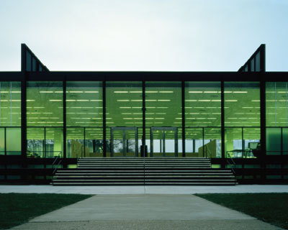
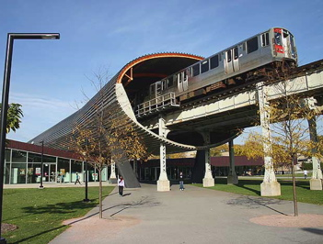
Architectural Significance of IIT
S.R. Crown Hall - National Historic Landmark, regarded
as Mies van der Rohe's masterpiece
McCormick Tribune Campus Center

Slide 9
REC 2014 Schedule at IIT
 | Day 1 | Day 2 | Day 3 | Day 4
8:00 - 8:30 |  | Opening remarks
8:30 -10:30 |  | Session I | Session I | Session I
10:30 - 11:00 |  | Break | Break | Break
11:00 - 12:20 |  | Session II | Session II | Session II
12:20 - 13:30 |  | Lunch | Lunch | Lunch
13:30 - 14:50 |  | Session II continued | Session II continued | Closing remarks
14:50 - 15:20 |  | Break | Break | Chicago Architectural Tour
15:20 - 17:00 |  | Session III | Session III
19:00 - 21:00 | Welcome Reception |  | Dinner Banquet

Slide 10
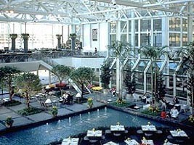
Accommodation for REC 2014
Hyatt Regency Chicago

Slide 11
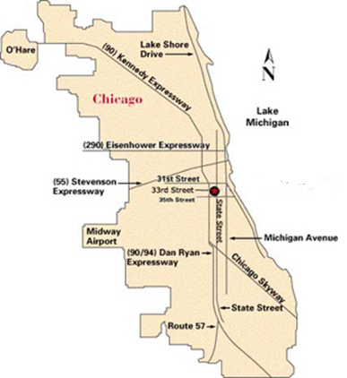
Accessibility
Chicago has two major airports
Midway International Airport
Located just 15 minutes away from IIT
O’Hare International Airport
One of the largest airports in the world
Located approximately 30 minutes away from IIT
IIT

Slide 12
Thanks
See you in Chicago!

