Slide 1


Model Uncertainty
&
Sensitivity Measures
Terje Haukaas, Associate Professor
Mojtaba Mahsuli, PhD Candidate
REC 2012, Brno, June 13-15

Slide 2

Vancouver

Slide 3
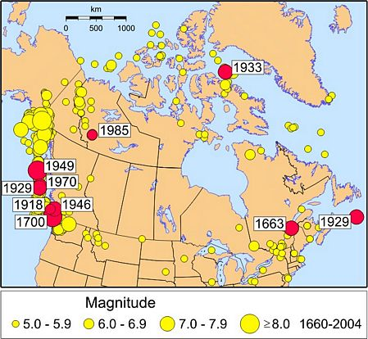
Source: “Earthquakes Canada”

Slide 4
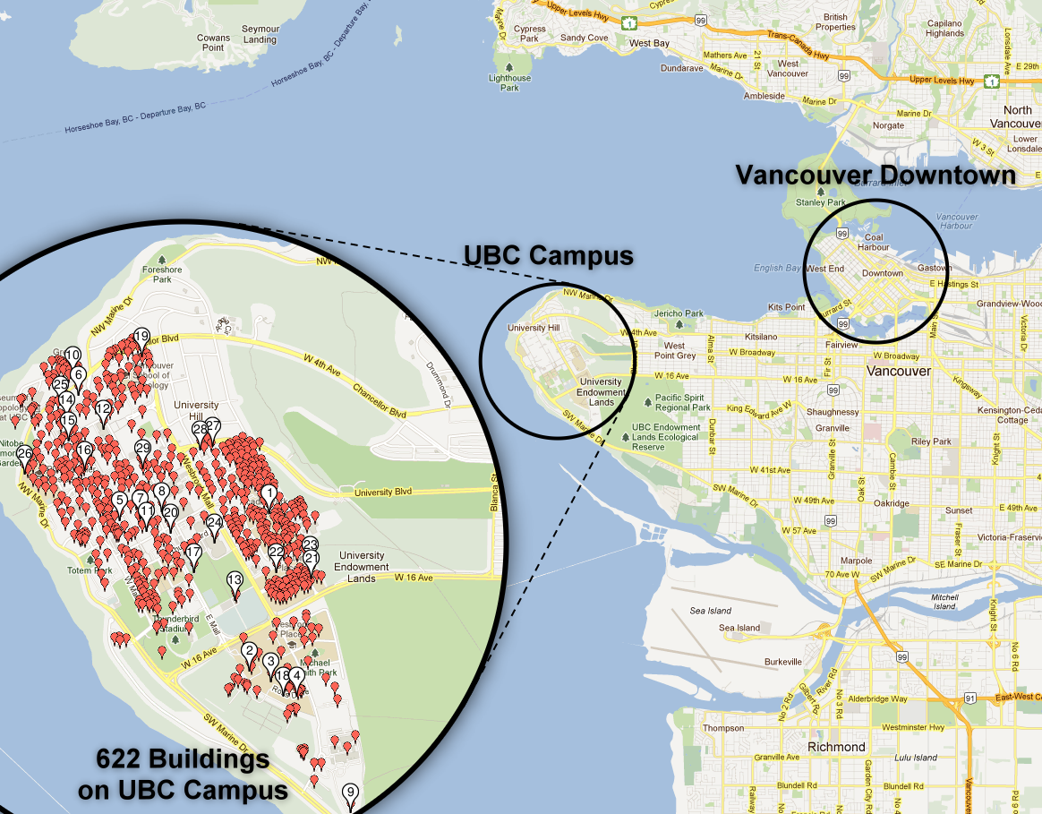

Slide 5
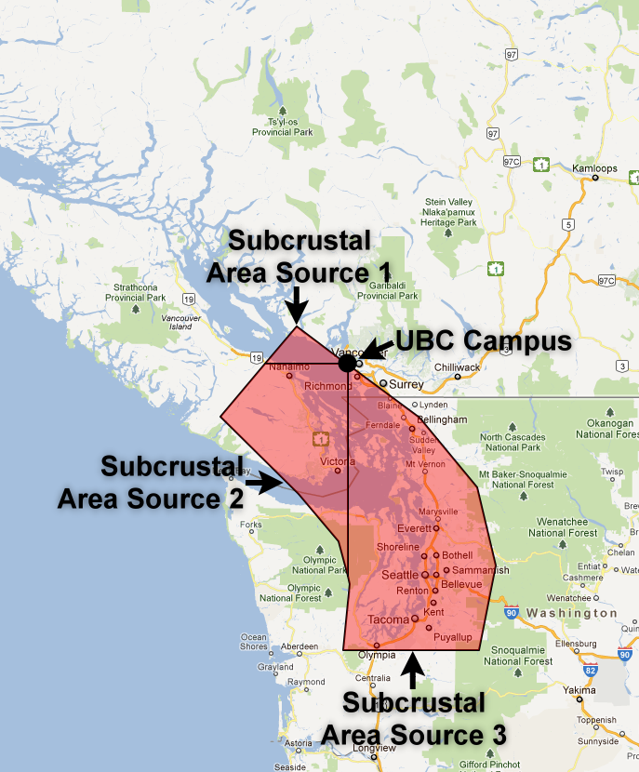
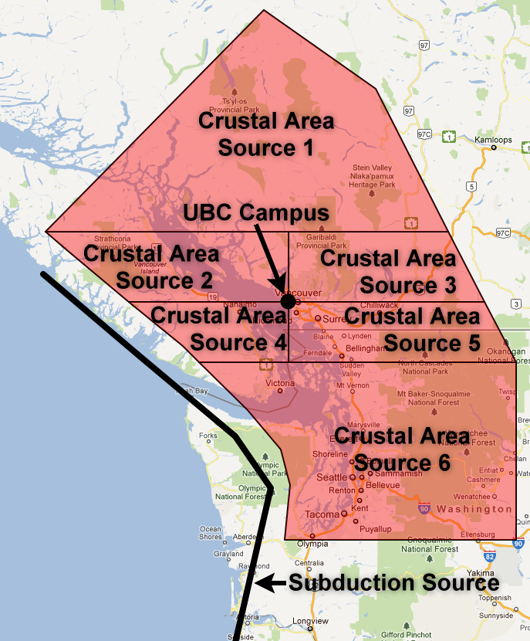

Slide 6
14 model types
4,389 model instances
281 random variables
8,097 response objects

Slide 7
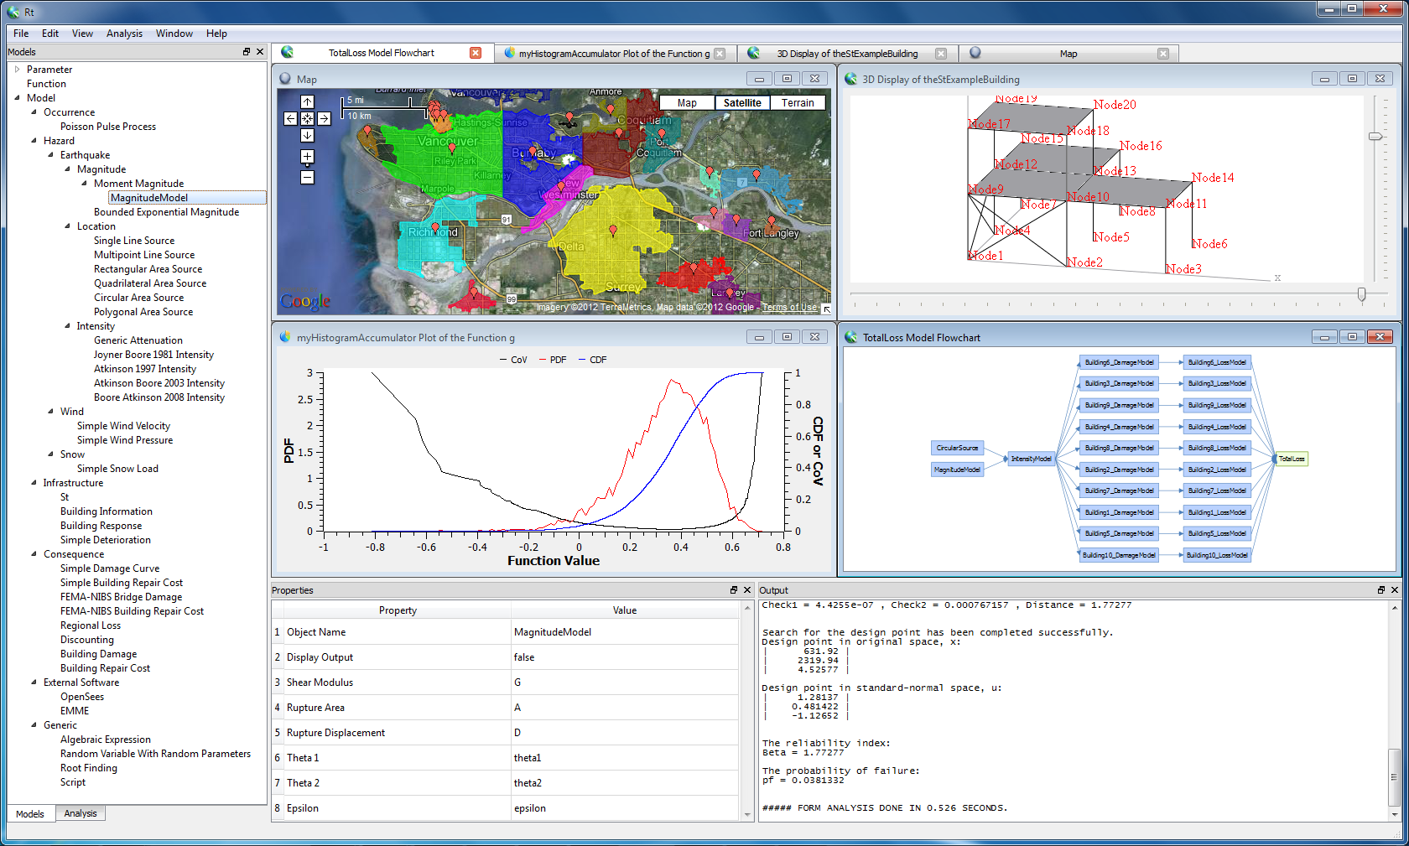

Slide 8
Object-oriented
Library of models
Random variable objects
Design variable objects
Response objects
Interactive GUI
FDM and DDM sensitivities
Multi-hazard
Free at www.inrisk.ubc.ca

Slide 10
A generic model:
“Aleatory” random variables

Slide 11
A generic model:
“Epistemic”
random
variables

Slide 12
A generic model:
Decision
variables

Slide 13
A generic model:
Limit-state function:
Result for each hazard:
Translated into probability:
Combination of hazards:
Translated back into reliability index:

Slide 14
Limit-state

Slide 15
Objective
Improve the quality of the risk analysis
Idea
Reduce epistemic uncertainty
Question
Which epistemic uncertainty to address?
… identifies model instances to be prioritized in near-term refinement efforts
… identifies model types to be prioritized in long-term research efforts

Slide 16
Derivation of :

Slide 19
Derivation of :
!

Slide 21
Another question
Which uncertainty is largest; seismic or structural?
A better way to ask that question
Which uncertainty should be addressed; seismic or structural?
Answer
It is far more effective to reduce the epistemic uncertainty
associated with structural performance

Slide 22
Summary:
Mechanics
+
Statistics
Design Procedures
Models
+
Methods
Engineering =
Design
Analysis
Decisions

Slide 23

Thank You for Your Attention
ICASP 12, Vancouver, Canada, 2015

